Slide 1
External Examiner Nomination Online Process
INSTRUCTIONS
10/01/2024

Slide 2
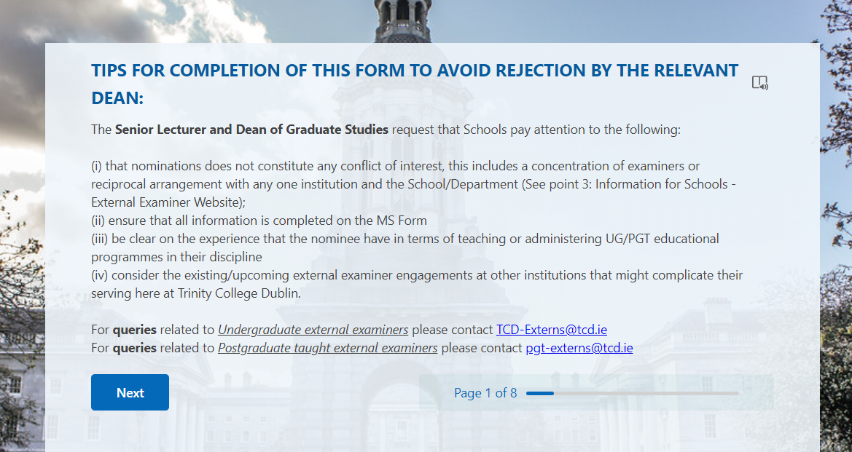
Instructions to be followed by the School
Schools' role
Click on the following link to open the Online EE Nomination Form: https://forms.office.com/e/bD1QQLcmxz
Make sure to address the tips put together for every nomination form to be submitted on behalf of your school. These tips will help the nomination to get the approval and avoid asking for additional information.
Make sure to select the School you are representing in Question 01 and the right level of examination in Question 06 (Undergraduate or Postgraduate according the role you are playing for this TEST)

Slide 3
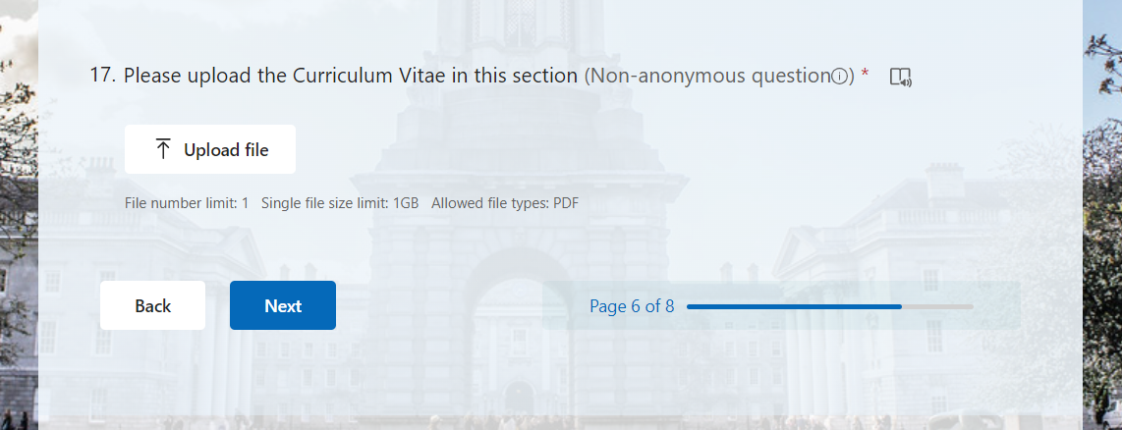
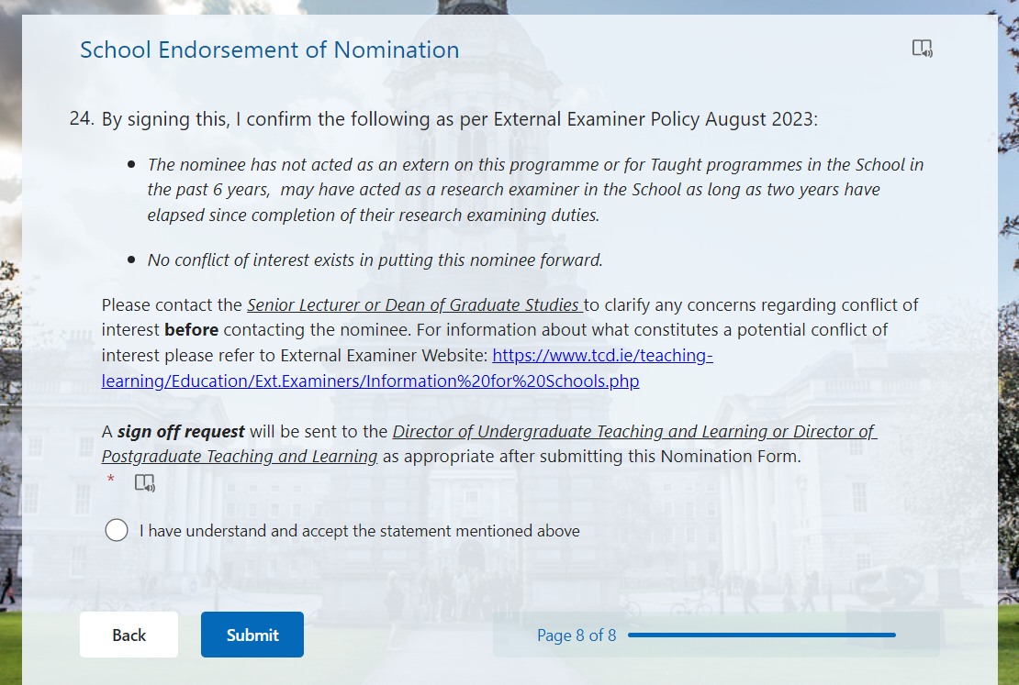
Instructions to be followed by the School
Schools' role
4) Make sure to upload the CV on PDF Format in Question 17
5) Complete the entire MS Form, accordingly, accept the External Examiner Policy statement and click Submit

Slide 4
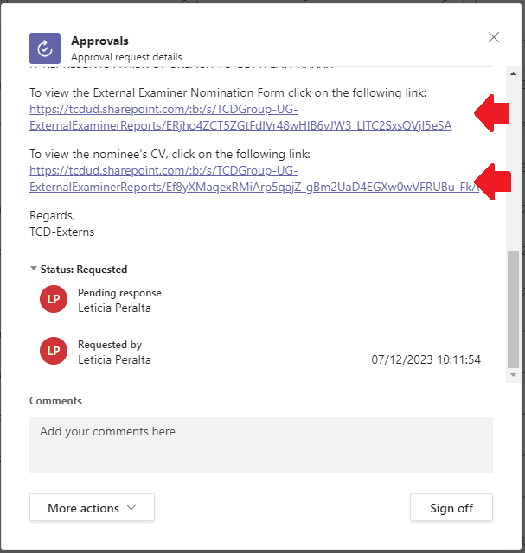
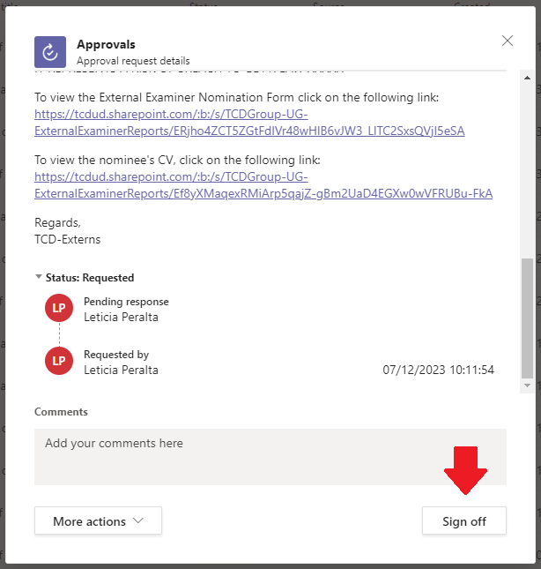
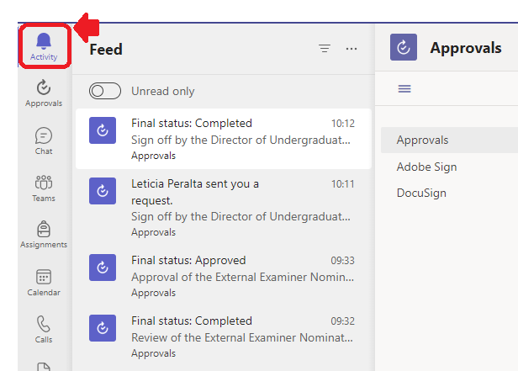
Instructions to be followed by the School
DUTL and DTLPG
A notification will be sent to the user accounts in the DUTL/DTLPG listing previously shared by the School Managers. This notification will be shown on your Teams APP and to signing off this request you will need to click on the Activity button on the top left.
After this, open the window and click on the two links to make sure you can see and review the EE Nomination Form and the CV attached. On this point is important to do not download any document to your computer to avoid any breach to GDPR.
Finally, on the comments box write the following: “Review and signed off by –Your name-”. Click on the “Sign off” button showed on the right bottom corner to complete your part of the process.
1)
2)
3)

Slide 5
Instructions to be followed by TTL/GSO
Trinity Teaching and Learning
Once the External Examiner MS Form is signed off by the DUTL/DTLPG, a notification will be sent to TCD-Externs@tcd.ie for Undergraduate nominations and to pgt-externs@tcd.ie for Postgraduate Taught nominations.
To review an External Examiner Nomination, go on your Teams App and click on Activity button on the top left. After this, open the window and click on the two links to make sure you can see and review the EE Nomination Form and the CV attached. On this point is important to do not download any document to your computer to avoid any breach to GDPR. If there are no queries, click on the Review button.
If there are any queries at this stage of the process, please click on the reject button and add your comments on the Comment Box from the Teams Notification. This will be sent back to the school (to the person that submitted the MS Form) as an email to address these queries and re-submit again through the online form: https://forms.office.com/e/bD1QQLcmxz.

Slide 6
Instructions to be followed by Senior Lecturer / Dean of Graduate Studies
Once the External Examiner MS Form has been reviewed by TTL/GSO and there are no queries, a notification will be sent to the Senior Lecturer or Dean of Graduate Studies for their Review and Approval
To review and approve an External Examiner Nomination, go on your Teams App and click on Activity button on the top left. After this, open the window and click on the two links to make sure you can see and review the EE Nomination Form and the CV attached. On this point is important to do not download any document to your computer to avoid any breach to GDPR. If there are no queries, click on the Approve button.
If there are any queries at this stage of the process, please click on the reject button and add your comments on the Comment Box from the Teams Notification. This will be sent back to the school (to the person that submitted the MS Form) as an email to address these queries and re-submit again through the online form: https://forms.office.com/e/bD1QQLcmxz.

Slide 7
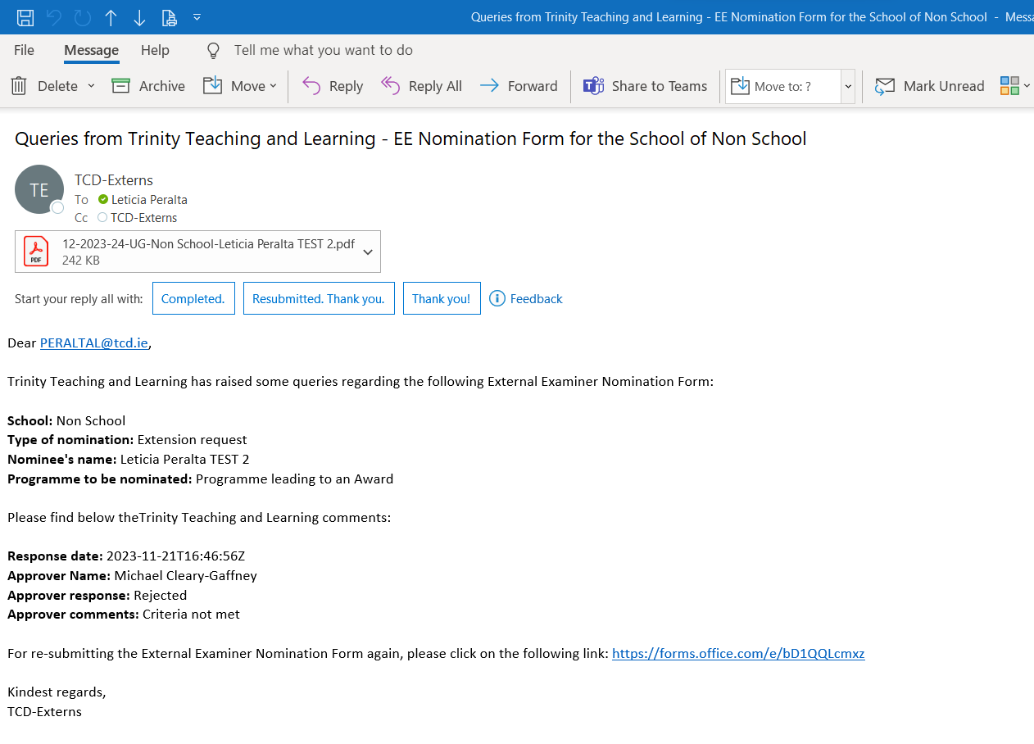
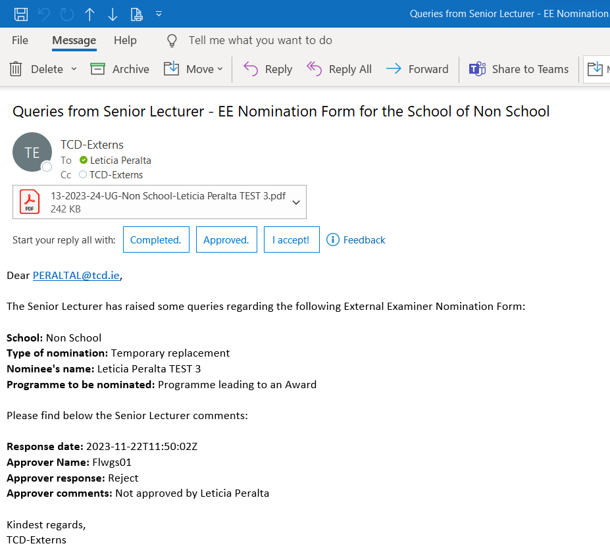
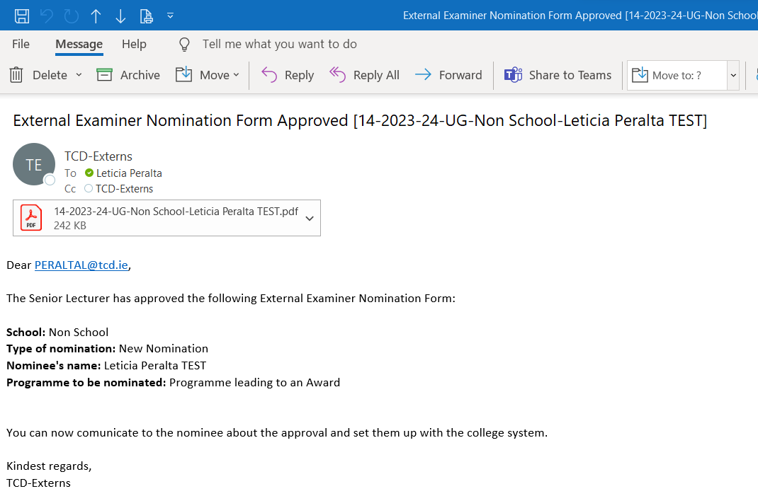
What happens next?
Depending on whether there are any queries regarding the External Examiner Nomination submitted, an email will be sent by TCD-Externs@tcd.ie for Undergraduate nominations and by pgt-externs@tcd.ie for Postgraduate Taught nominations to address such comments.
If there are no queries an Approval Email will be sent to the School to start with the External Examiner set up in the Trinity College Dublin System.
Example of Email notification when TTL/GSO raise queries
Example of Email notification when SL/DGS raise queries
Example of Email notification when EE Nomination Form has been approved

